Slide 1



Baseball Analysis

Slide 2
Summary
How can historical baseball statistics help us with baseball predictions?

Slide 3
Summary cont.
Where do professional players come from?
Should the National League adopt the DH rule?
What caused the 1990’s spike in pitching era and batting average?
Does professional experience improve fielding percentage?

Slide 4
How to Answer
Jupyter Notebook, Pandas, MatplotLib and Numpy
CSV files from Kaggle: The History of Baseball
Fielding
Pitching
Batting
Players
Online history of baseball

Slide 5
Data Cleanup
Source provided 29 csv files with a total of 704 columns
Cleanup process:
Select csv files
Determine necessary columns
Focus on US born for location
Selected AL and NL leagues
Limited data to more recent years
When combining files selected appropriate field to merge on

Slide 6
Set-backs
Deciding which data to use and what questions to ask
Individual player data could be separated for the same year if different position and/or team
Outside factors could influence stats

Slide 7
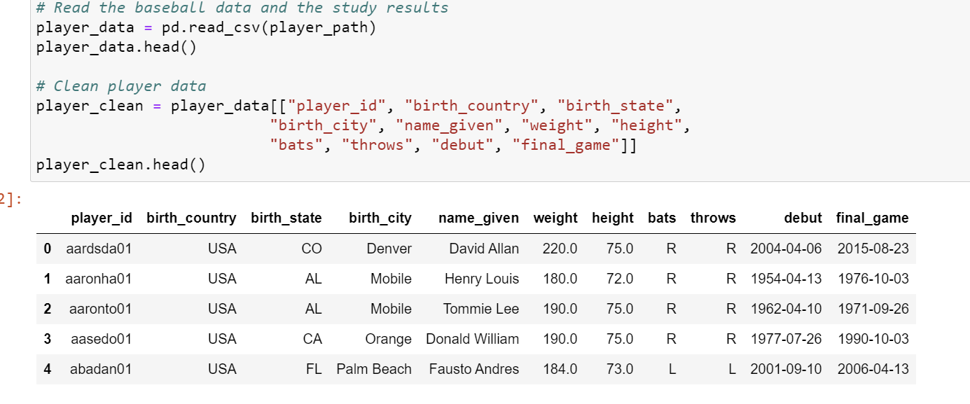
Analysis
Cleaning up the player data
Reduced columns

Slide 8
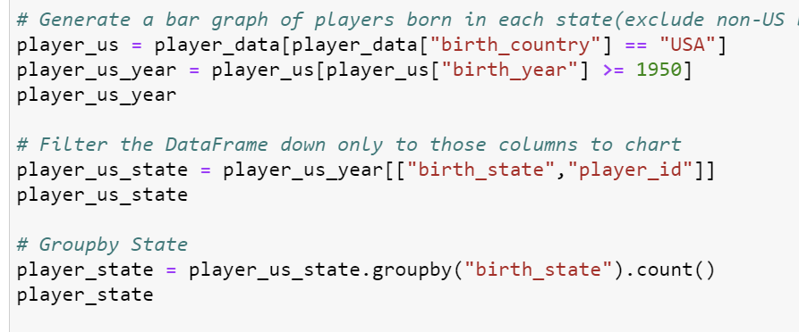
Analysis
2. Where are players from?
Focused on players born after 1950
US born only

Slide 9
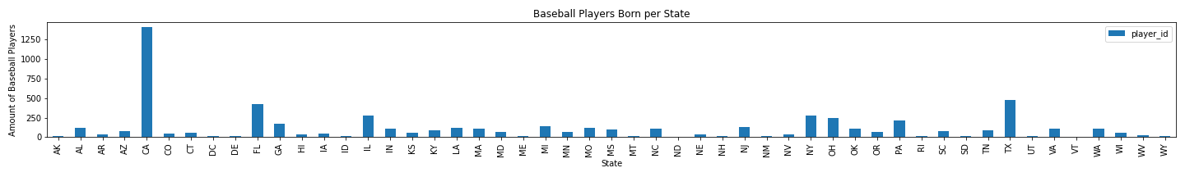
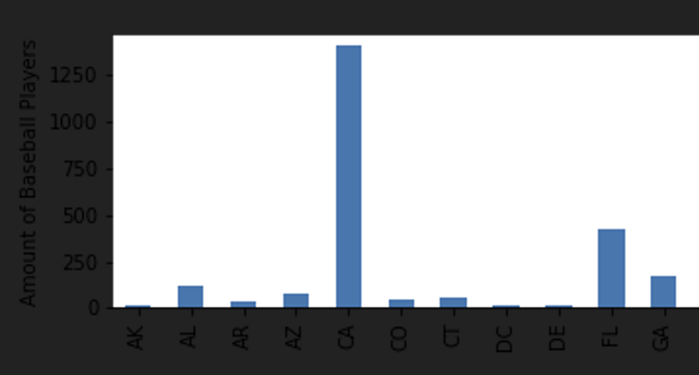
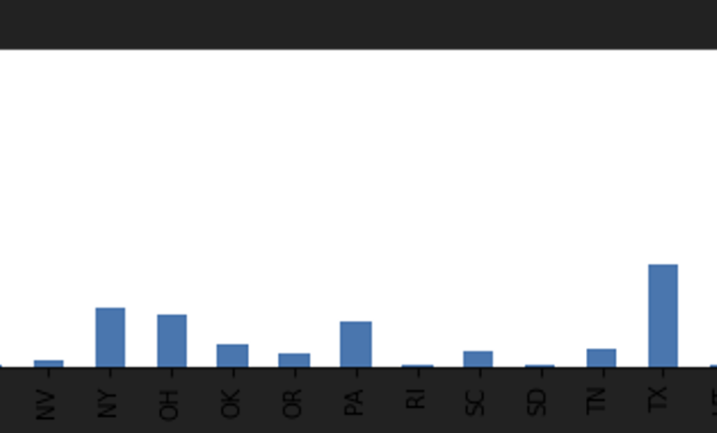
Figure 1

Slide 10
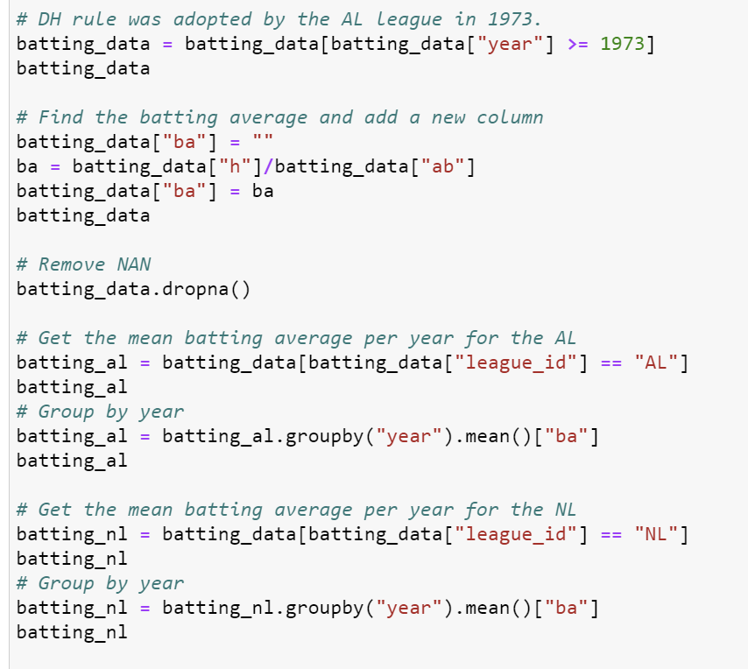
Analysis
3. Should the NL adopt the DH rule?
DH rule adopted by AL in 1973
Data from 1973-2015
Grouped by each league and found the average batting average per year
Batting average = hits/at bats

Slide 11
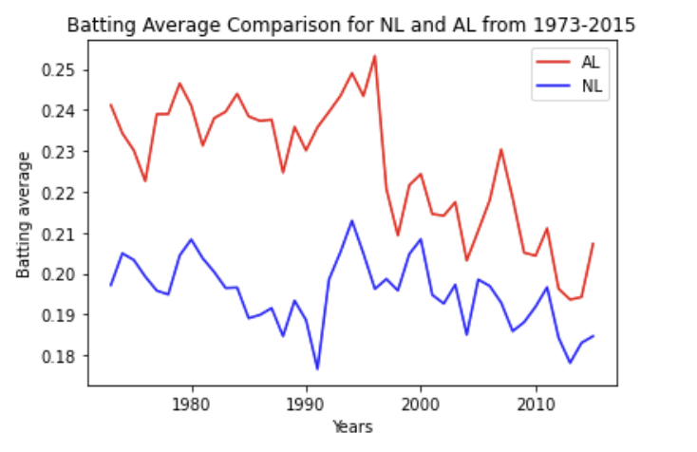
Figure 2

Slide 12
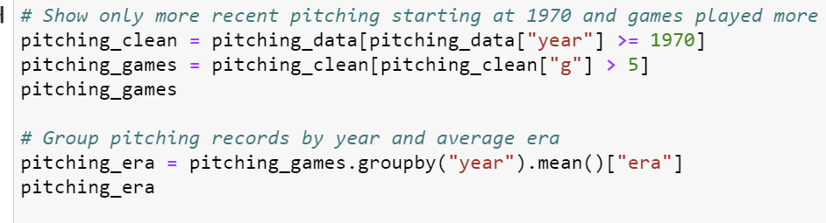
Analysis
4. Has pitching era improved?
Years 1970-2015
More than 5 games pitched/year
Average era per year

Slide 13
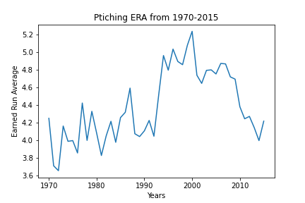
Figure 3

Slide 14
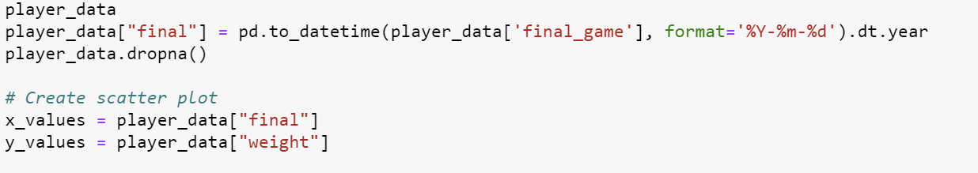
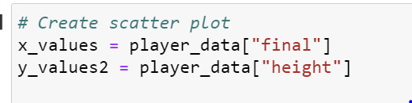
Analysis
5. What caused the era and batting average spike in the 90’s
Player weight and height over the years

Slide 15
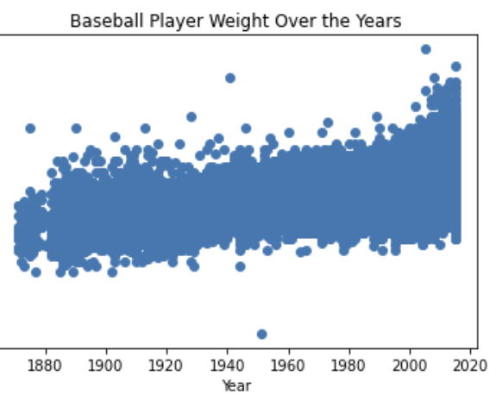
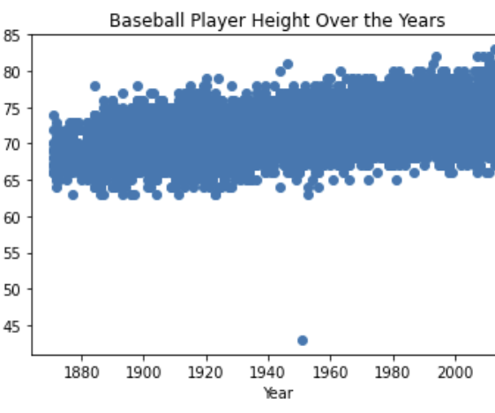
Figure 4 & 5
Weight
Height

Slide 16
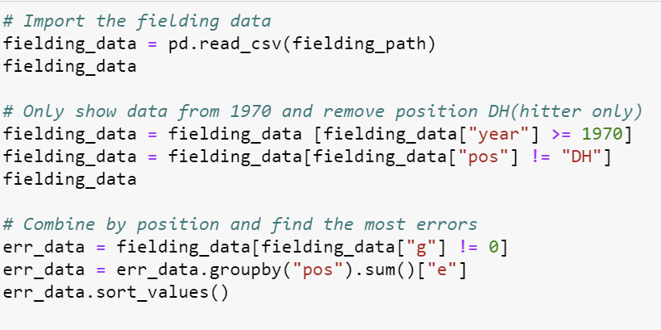
Analysis
6. What position has the most errors?
Years 1970-2015
Removed DH position
Sum of errors per each position

Slide 17
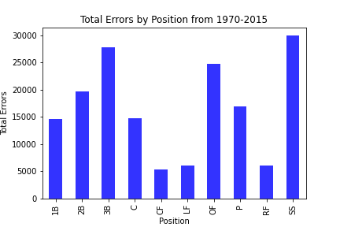
Figure 6

Slide 18
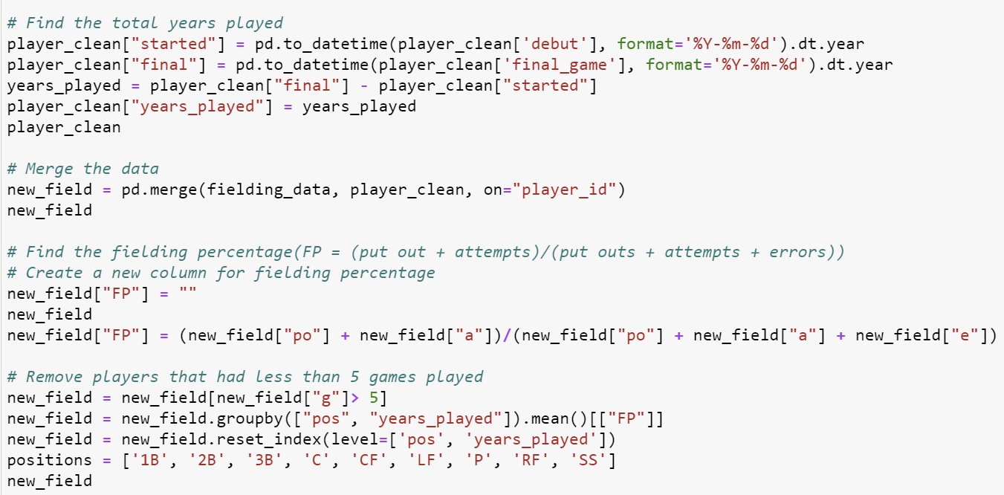
Analysis
7. Does experience in professional baseball improve fielding percentage?
Found total years played from player csv
Merged with fielding
Fielding percentage = (put outs + attempts)/ (put outs + attempts + errors)
More than 5 games played

Slide 19
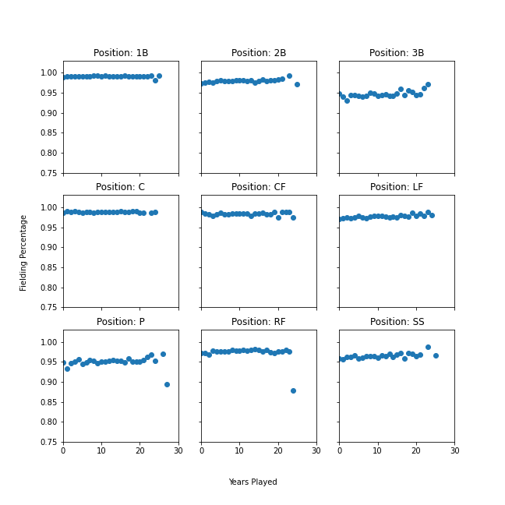
Figure 7

Slide 20
Discussion
Stats can help see how a player will measure up in the professional league
Is a minor league player ready for MLB
Interesting the significant difference of where players are born
Expected AL to have better overall batting average
Was a trend in the 90’s – 00’s, but could not pinpoint to one cause
Fielding stats very consistent
Small percentage make it to professional
If errors increase will be taken out of the game

Slide 21
What if?
Would like to include post-season analysis
Take a deeper dive into pitching stats
Has pitching changed over the years?
Are there more lefty pitchers?
Change in strikeouts? Or total pitches per game?
Compare the top players over the years

Slide 22
Questions?

